Slide 1
CLOUD COMPUTING
CASE SCENARIO: GOOGLE DRIVE

Slide 2
GOOGLE DRIVE
When Google Drive first launched, it served as a place to store your files in the cloud so that they could be accessed anywhere. As Drive has evolved, it has assimilated the roles of Google Docs and now serves as the hub for all Google document creation and office tools. You can even install apps into Drive to expand its functionality even further. Get the most out of Google Drive by following this guide.

Slide 3
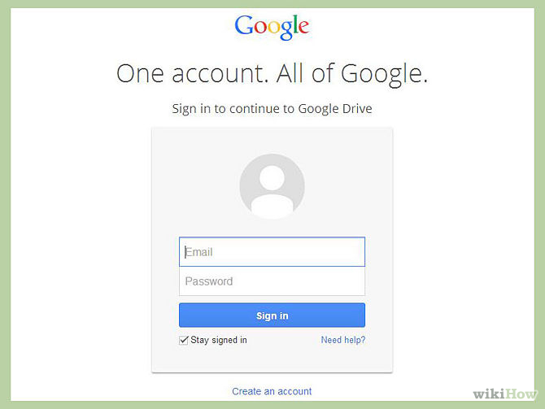
Accessing Google Drive

Slide 4
Sign into the Google Drive website with your Google account.
If you don’t have a Google account, you can create one for free. Google Drive will allow you to store your files in the cloud, as well as create documents and forms through the Google Drive web interface.

Slide 5
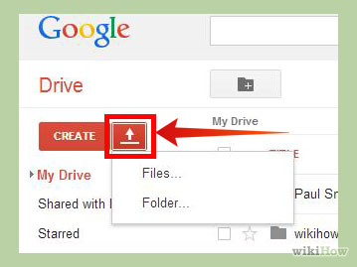
Add files to your drive: There are two ways to add files to your drive. You can create Google Drive documents, or you can upload files from your computer. To create a new file, click the CREATE button. To upload a file, click the “Up Arrow” button next to the CREATE button.

Slide 6
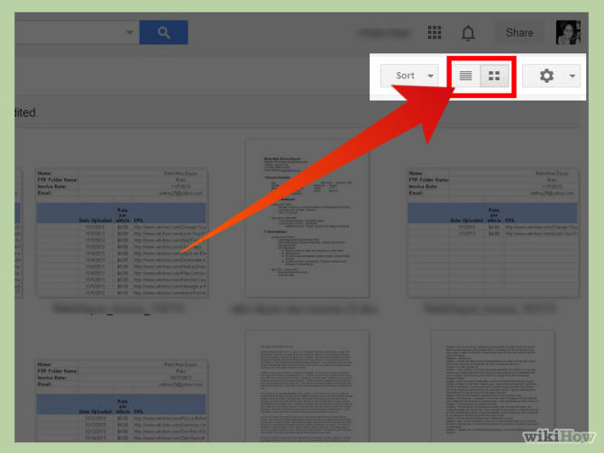
Change the way your files are displayed: You can choose to display files by large icons (Grid) or as a list (List). The List mode will show you at a glance the owner of the document and when it was last modified. The Grid mode will show each file as a preview of its first page. You can change the mode by clicking the buttons next to the gear icon in the upper right corner of the page.

Slide 7
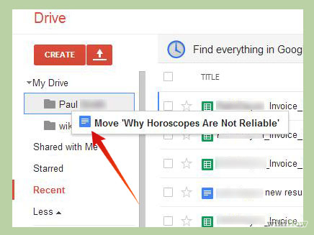
Use the navigation bar on the left side to browse your files: “My Drive” is where all of your uploaded files and folders are stored. “Shared with Me” are documents and files that have been shared with you by other Drive users. “Starred” files are files that you have marked as important, and “Recent” files are the ones you have most recently edited.You can drag and drop files and folders around your Drive to organize them as you see fit.

Slide 8
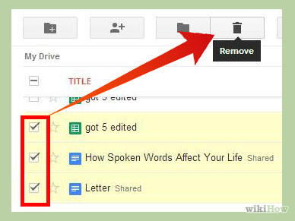
Selecting multiple folders: Click the check box to select multiple files and folders. You can then perform actions for these selected files by clicking the buttons at the top of the page. If you are using the large icon view, the check box appears when you hover your mouse over the document. There are more options in the “More” menu.

Slide 9
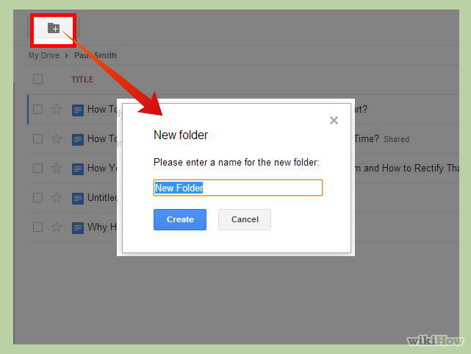
Creating new folder: Click the Folder icon with a “+” sign to create a new folder in your Drive. You can create folders inside of other folders to organize your files.

Slide 10
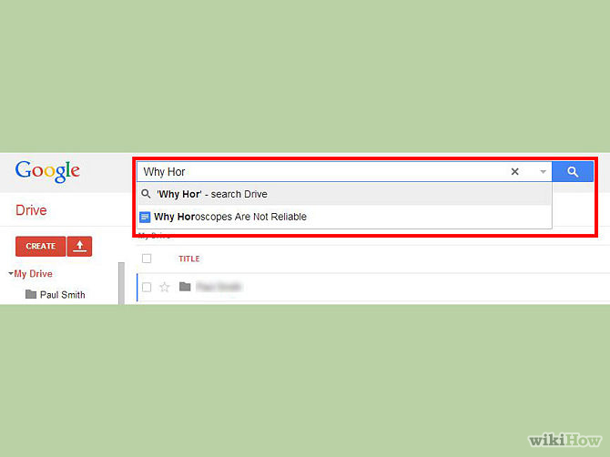
Search for files. You can search through your Google Drive documents and folders using the search bar at the top of your page. Google Drive will search through titles, content, and owners. If a file is found with the exact term in the title, it will appear under the search bar as you type so that you can quickly select it.

Slide 11
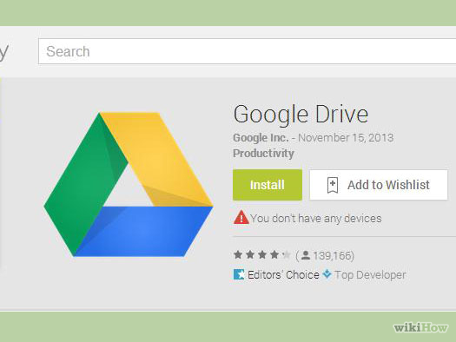
Download the app for your mobile device. You can download the Google Drive app for your Android or iOS device which allows you to access your files from your phone or tablet. The app can be downloaded for free from your app store. The app may not have all of the same editing features as the browser version.

Slide 12
Creating and Editing Documents
Click the CREATE button. A menu will appear that allows you to choose what type of document you want to create. You have several options by default, and more can be added by clicking the “Connect more app” link at the bottom of the menu:Folder – This creates a folder in your My Drive for file organization.
Document – This creates a blank word processor document. You can adjust formatting and page setup using the tools and menus at the top of the document. You can export documents into Microsoft Word, OpenOffice, PDF, and other formats.
Presentation – This opens the Google Drive equivalent of Microsoft PowerPoint. Files can be exported as Microsoft PowerPoint, PDF, JPG, and other formats.
Spreadsheet – This creates a blank spreadsheet. Spreadsheets can be exported as Microsoft Excel, OpenOffice, PDF, CSV, and other formats.
Form – This allows you to create forms that can be filled out online. Forms can be exported to CSV files.

Slide 13
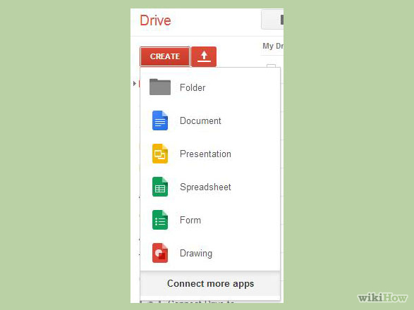
Creating and Editing Documents

Slide 14
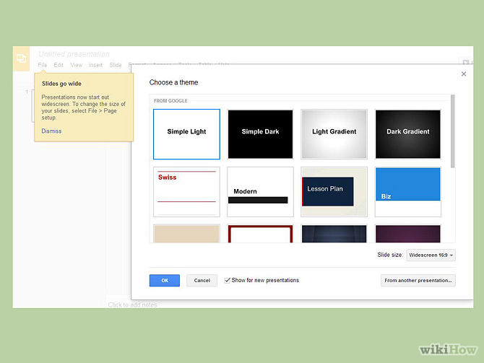
Create a new file. Once you’ve selected your document type, you will be taken to your blank document. If you chose Presentation or Form, you will be greeted by a wizard that will help you configure the feel of your document.

Slide 15
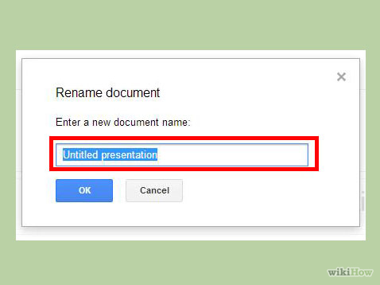
Name the file. At the top of the page, click the italic gray text that says “Untitled <file type>”. When you click it, the “Rename document” window will appear, allowing you to change the name of your file.

Slide 16
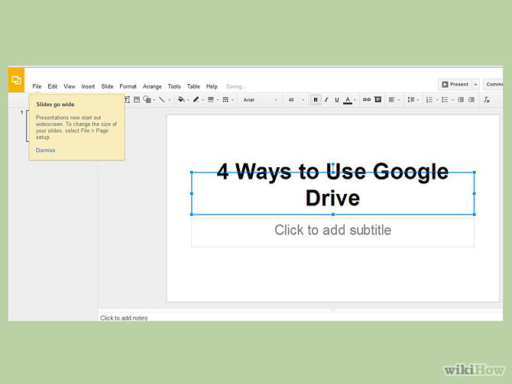
Edit your document. Begin writing your document as you would in its commercially-equivalent. You will most likely find that Google Drive has most of the basic features, but advanced features you may be used to are not available.Your document saves automatically as you work on it.

Slide 17
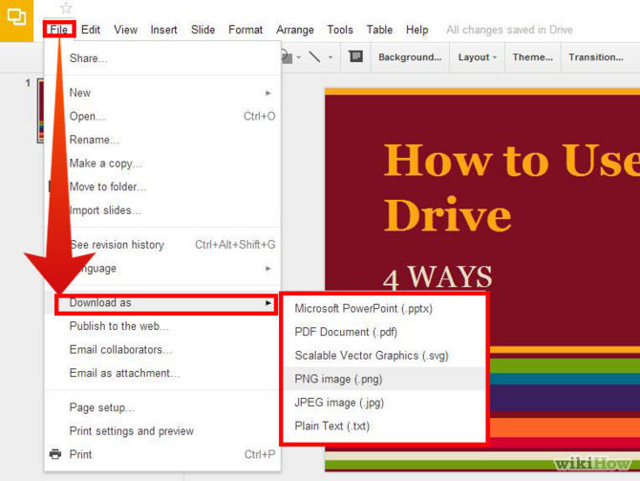
Export and convert the file. If you want to make your file compatible with similar programs, click File and place your cursor over “Download As”. A menu will appear with the available formats. Choose the format that best suits your needs. You will be asked to name the file and select a download location. When the file is downloaded, it will be in the format you chose.

Slide 18
Share your document. Click File and select Share, or click the blue Share button in the upper right corner to open the Sharing settings. You can specify who can see the file as well as who can edit it.
Give the link at the top to the people you are sharing the file with. You can use the buttons below to quickly share via Gmail, Google+, Facebook, or Twitter.Change who has access to the document by clicking the “Change…” link. By default, the document is private and you must invite people for them to have access. You can change this to allow everyone who has the link, or to open and searchable by the entire internet.Invite people to edit your document by entering their contact information into the “Invite people” field. Invited users must sign in to Google Drive in order to access the document.Change invited people’s access by clicking the blue link next to each to their names. You can allow them to edit the document or just be able to view it.

Slide 19
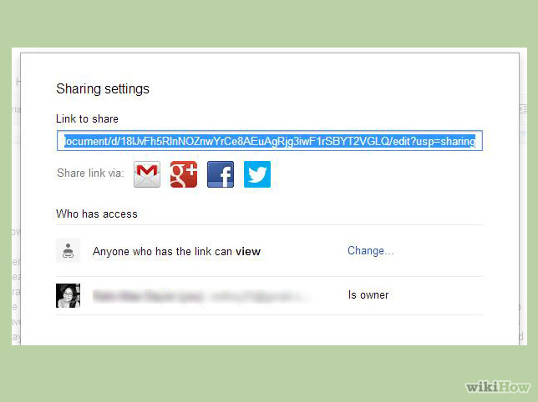
Share your document

Slide 20
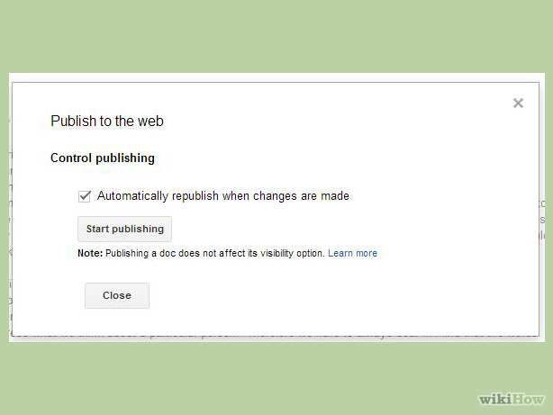
Publish the document. To publish your document, spreadsheet, or presentation, click File and select “Publish to the web”. Publishing a Google Drive document creates a copy of that document that anyone can see. The copy becomes a separate webpage that is not linked to your original document. This allows you to share the document with anyone you want without changing your sharing settings.^{[1]}A published document cannot be edited. You can still edit the original file that remains in Google Drive.

Slide 21
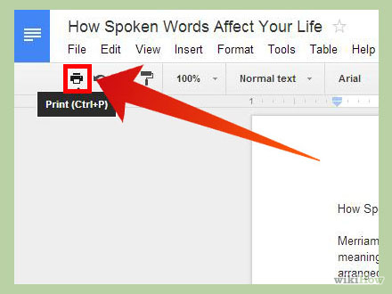
Print the document. If you have a printer installed or have access to a Google Cloud printer, you can print your documents. Click on the File menu and select Print from the bottom of the list.
Choose your print settings. You can specify which pages to print, as well as the layout of the page. Click Print to move to the next screen.The print preview will open, and you can select your printer by clicking the Change button. This is useful if you are trying to access your Google Cloud printer at home while out at work or school.

Slide 22
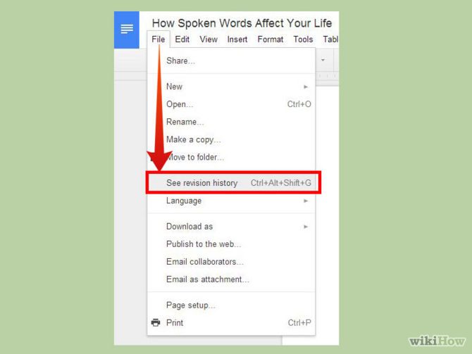
Revert to an older version of a document. If you’ve made a bunch of changes to a document and realize you need to revert back to your old version, you can use the Revision History tool to browse through old copies. Open the document and click the File menu. Select “See revision history” and a frame with a list of your revisions will open on the right side of the page.^{[2]}You can click on each revision on the list to see the document I your main window.
When you’ve found the revision you want to keep, click the blue “Restore this revision link” underneath its entry on the list.

Slide 23
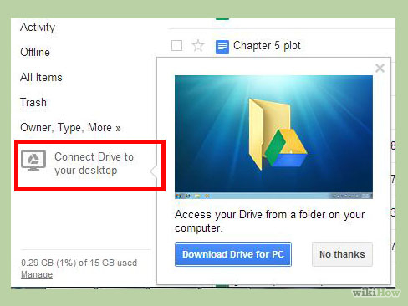
Download the Google Drive sync program for your computer. This is optional, but can make syncing your local files to Google Drive easier. If you want to install the program, click the link to download it on the Google Drive homepage. The link will download the correct installer for your operating system.
Once you download the program, install it and sign in with your Google account. A folder will be placed on the desktop that gives you quick access to all of your Google Drive files.
Drag any files that you want to add to your Google Drive storage into the folder and they will be automatically uploaded. When a file is successfully uploaded, it displays a green check mark on the icon.

Slide 24
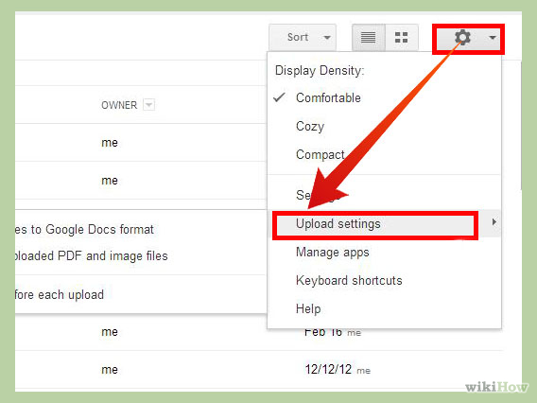
Set your upload settings. Click the gear icon in the upper right corner of the page and hover your mouse over the “Upload settings” option. You can choose to have Google Drive automatically convert uploaded files such as Word documents or Excel files into the Drive formats, and you can have Drive convert PDF files into editable text files.You can select if you would like to be prompted every time you do this, or if you want it to happen automatically.
Unconverted files will not open in Google Drive unless you convert them. Otherwise you will need to download them to a machine that has the program required to open the file.

Slide 25
Click the Upload button. A menu will appear allowing you to upload individual files or entire folders. Browse for the file or folder that you want to upload to Drive. Your conversion settings set earlier will take effect, and you can see the progress of the upload in the window that appears.Free Google Drive accounts give you 15 GB of storage for your uploaded files. This storage is shared with your Gmail account. Any documents created in Drive do not count towards your storage limit. You can see what is taking up your storage by clicking the “Manage” link in the bottom left corner of the Drive page.

Slide 26
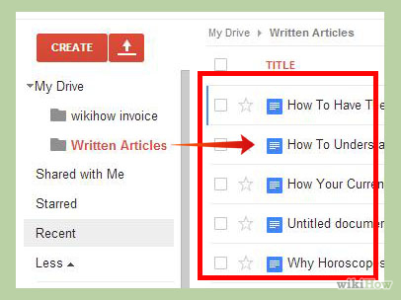
Files uploaded appear in your My Drive folder. You can then move them around your folder system however you’d like.

Slide 27
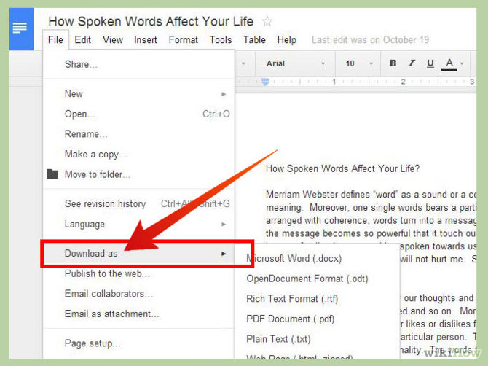
Download files from Google Drive to your computer. If you want to get a file or files onto your local computer, check the boxes for the files that you want to transfer. Click the More button at the top of the page and select Download.If you are downloading Google Drive files, you will be asked what format you would like to convert them too. Otherwise, your files will begin downloading automatically.

Slide 28
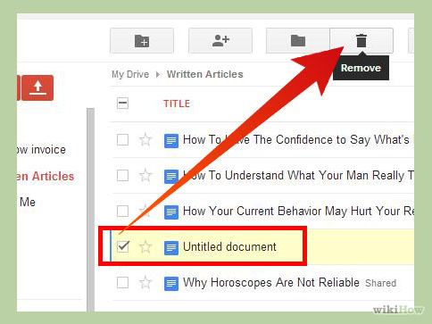
Delete files you don’t want. To delete files and folders, check the boxes for the items you want to delete. Click the Trash button at the top of the page. You can undo your action by clicking the Undo link, or by going to the Trash section in the left menu.Remember, documents created with Google Drive do not count towards your storage limit.

Slide 29
The END

